Slide 1
Course Introduction
Information Retrieval (IR)
-- Information Extraction (IE)
Semantic Networks
Natural Language Processing (NLP)
Data/Information/Knowledge/Intelligence

Slide 2
What is information retrieval?
Introduction to (traditional) Information Retrieval
https://www.youtube.com/watch?v=kNkCfaH2rxc

Slide 3
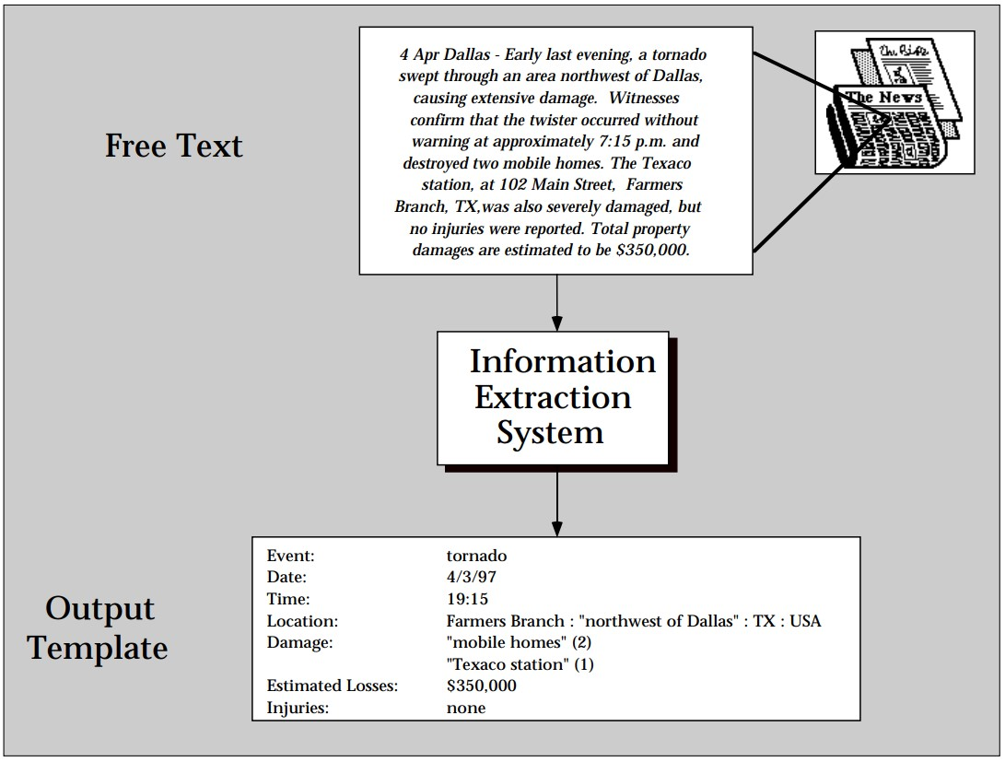
What is information extraction?
C. Cardie, "Empirical methods in information extraction," AI magazine, vol. 18, no. 4, pp. 65-65, 1997.

Slide 4
What is semantic networks?
A simple introduction to semantic networks
https://www.youtube.com/watch?v=K-yrnyvqXGo
Due to the strong accent and the dialect in the video, you might consider to turn-off the voice (it would remain understandable!!)
Another similar explanation with some additional information/elements: https://www.youtube.com/watch?v=3PgIC9KcSNE
Inheritance; Reasoning (Inference); Exception handling
A more detailed and complete introduction
https://www.youtube.com/watch?v=sY0kbo251A4
WordNet
The Semantic Web

Slide 5
Traditional Information Retrieval-- Basics
Term-document matrices
https://www.youtube.com/watch?v=e81nC0LO0A8&list=PLaZQkZp6WhWyvdiP49JG-rjyTPck_hvEu&index=34
The inverted index
https://www.youtube.com/watch?v=Wf6HbY2PQDw&t=2s
Query processing with the inverted index
https://www.youtube.com/watch?v=5KbynCj7yRQ
The Boolean retrieval model and an extended Boolean model
https://www.youtube.com/watch?v=TIN_02pJU-Y&t=54s
Phrase queries and positional indexes
https://www.youtube.com/watch?v=QVVvx_Csd2I

Slide 6
Traditional Information Retrieval-- Ranked Retrieval
Introducing ranked retrieval
https://www.youtube.com/watch?v=ZrNmCtSrL48
Scoring with the Jaccard coefficient
https://www.youtube.com/watch?v=MiX8_JVP6PE
Term-frequency weighting
https://www.youtube.com/watch?v=9UXM2NXVYY0
Inverse document frequency weighting
https://www.youtube.com/watch?v=7nWlI_TVid0
TF-IDF weighting
https://www.youtube.com/watch?v=4-P3ckZprBk

Slide 7
Traditional Information Retrieval-- Ranked Retrieval (2)
The vector space model
https://www.youtube.com/watch?v=o5nflzfX5tw&t=415s
Calculating TF-IDF cosine scores
https://www.youtube.com/watch?v=k1tD7pYKWuM
Evaluating search engines
https://www.youtube.com/watch?v=b7pfLpVBN84

